Slide 1
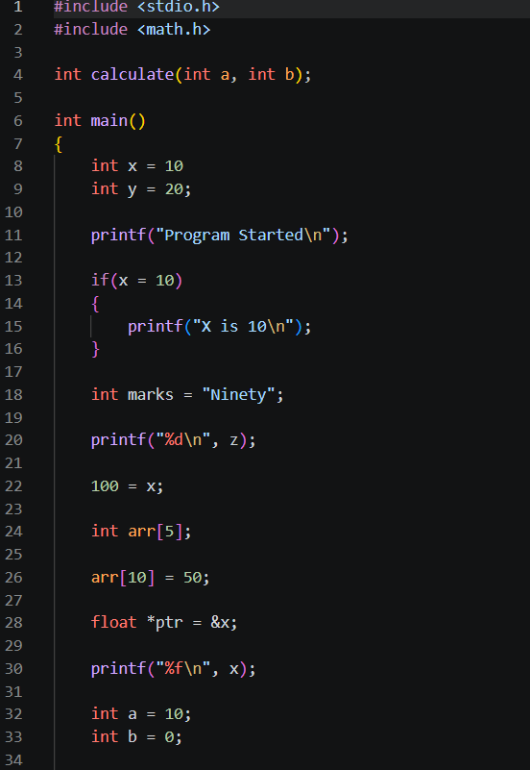
Assignment 4
Error Analaysis
problem no 1
Line No. | Type | Error | Correction
8 | Syntax | Missing ; after int x = 10 | int x = 10;
13 | Logical | if(x = 10) uses assignment | if(x == 10)
18 | Semantic | String assigned to int | int marks = 90;
20 | Semantic | z not declared | Declare z
22 | Syntax/Semantic | 100 = x invalid | x = 100;
26 | Runtime | arr[10] out of bounds | Use index 0–4
28 | Semantic | Wrong pointer type | int *ptr = &x;
30 | Runtime | %f used for int | %d
error analysis

Slide 2
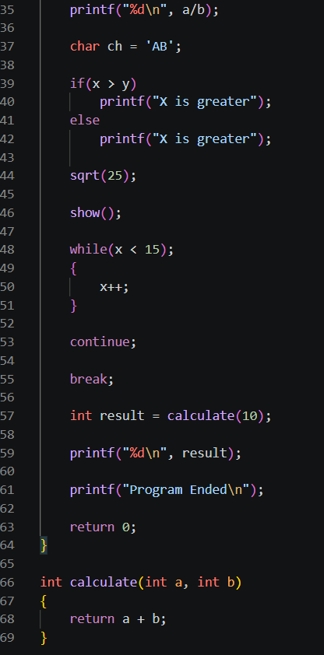
problem no 1
error analysis
Line No. | Type | Error | Correction
35 | Runtime | Division by zero | Ensure b != 0
37 | Semantic | 'AB' assigned to char | 'A'
42 | Logical | Same output in both branches | Change else message
44 | Logical | sqrt() result ignored | Store/print result
46 | Semantic | show() undefined | Define function
48 | Logical | Extra ; after while | Remove ;
55 | Syntax | continue outside loop | Put inside loop
57 | Syntax | break outside loop | Put inside loop/switch
59 | Semantic | One argument passed | calculate(10,20)
69 | Semantic | Function requires 2 parameters | Match function call

Slide 3
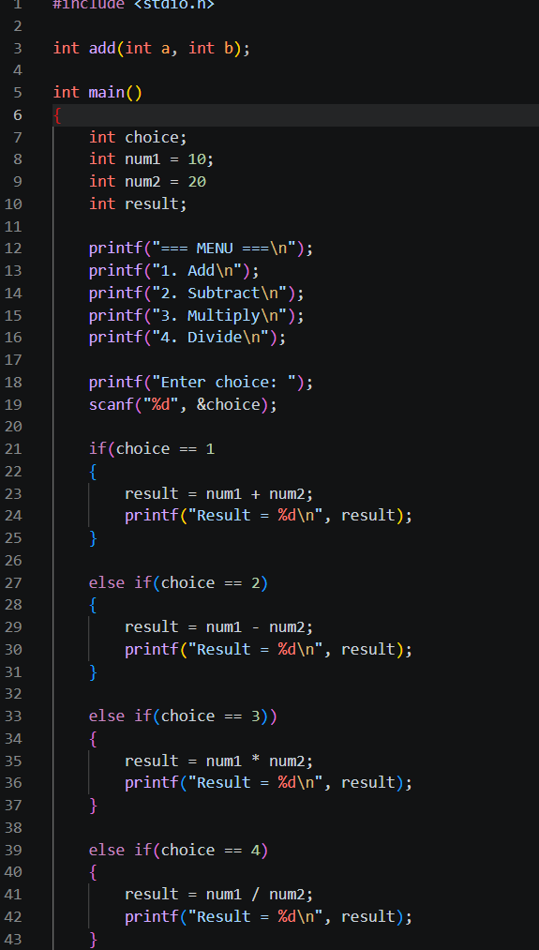
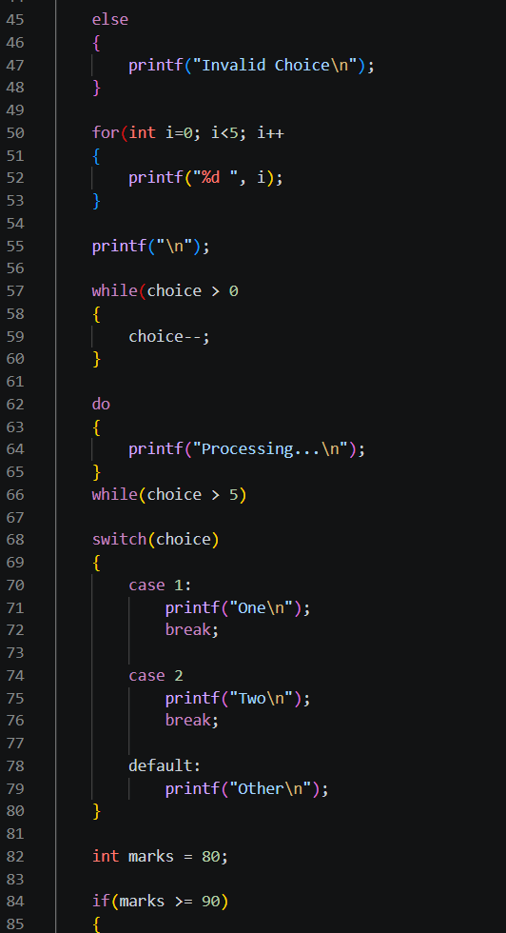
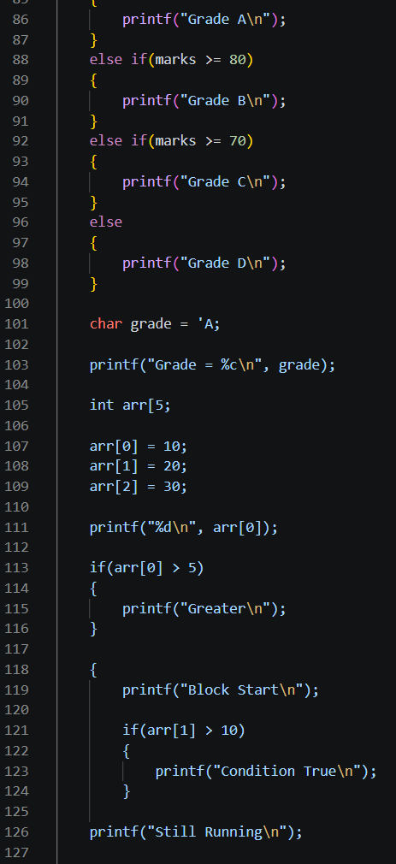
problem no 2

Slide 4
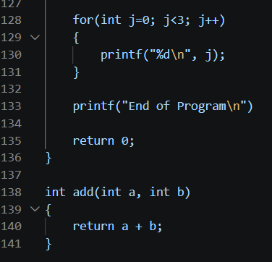
problem no 2
error analysis
Line No. | Error Type | Error | Correction
8 | Syntax Error | Missing semicolon after int num2 = 20 | int num2 = 20;
19 | Syntax Error | Missing closing parenthesis in if(choice == 1 | if(choice == 1)
30 | Syntax Error | Extra closing parenthesis in else if(choice == 3)) | else if(choice == 3)
43 | Syntax Error | Missing closing parenthesis in for(int i=0; i<5; i++ | for(int i=0; i<5; i++)
50 | Syntax Error | Missing closing parenthesis in while(choice > 0 | while(choice > 0)
58 | Syntax Error | Missing semicolon after while(choice > 5) in do-while loop | while(choice > 5);
66 | Syntax Error | Missing colon after case 2 | case 2:
90 | Syntax Error | Missing closing quote in char grade = 'A; | char grade = 'A';
94 | Syntax Error | Missing closing bracket in array declaration int arr[5; | int arr[5];
117 | Syntax Error | Missing semicolon after printf("End of Program\n") | printf("End of Program\n");
120 | Syntax Error | Missing closing brace } for the block opened near line 106 | Add } before return 0;

Slide 5
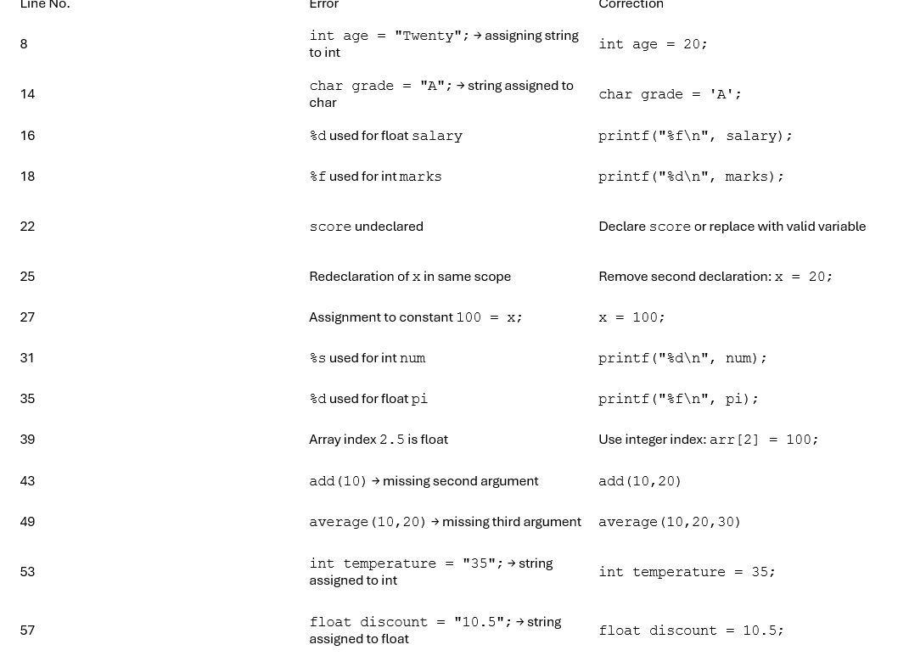
problem no 3

Slide 6
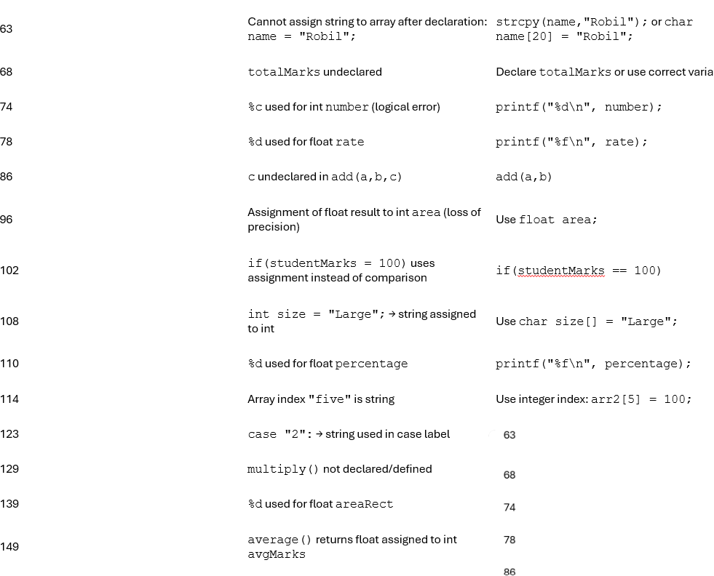
problem no 3

Slide 7
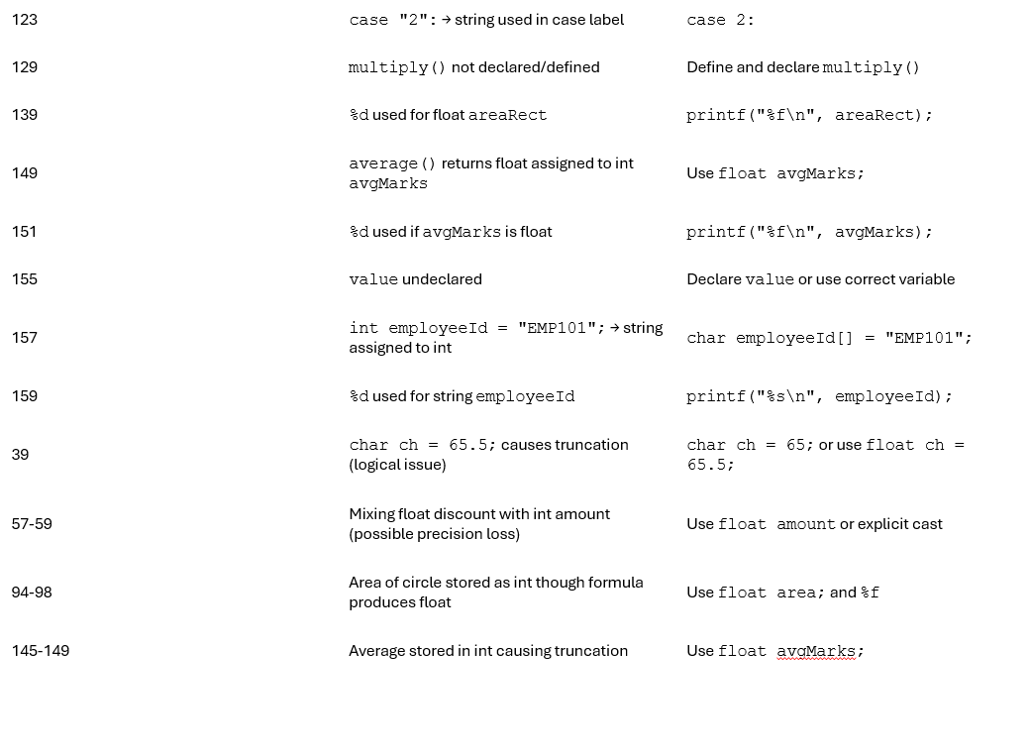
problem no 3

Slide 8
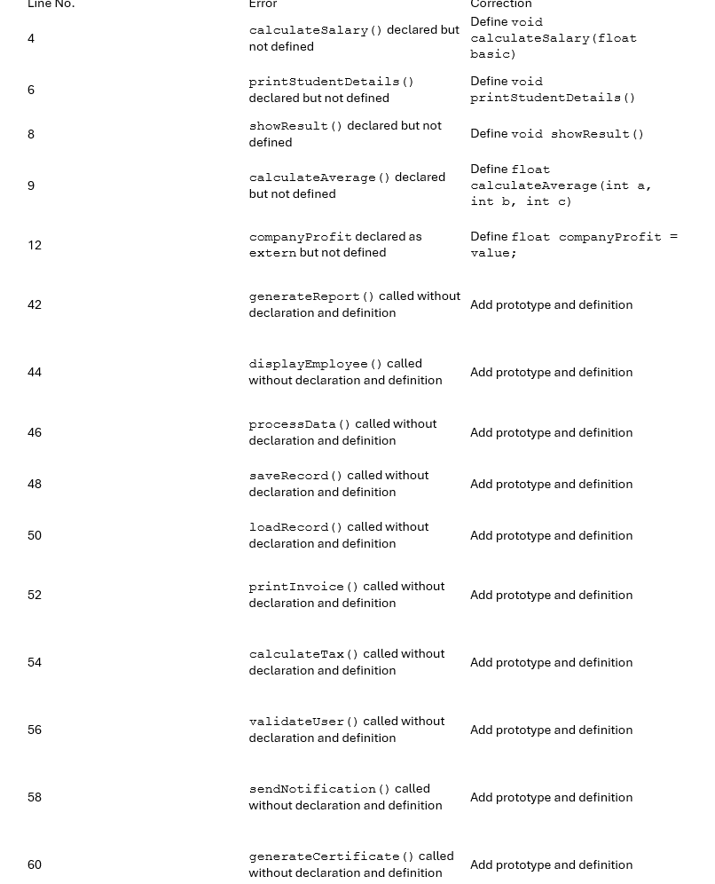
problem no 4

Slide 9
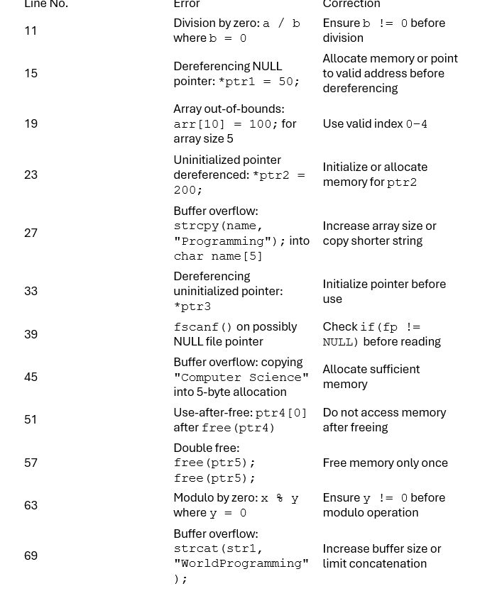
problem no 5

Slide 10
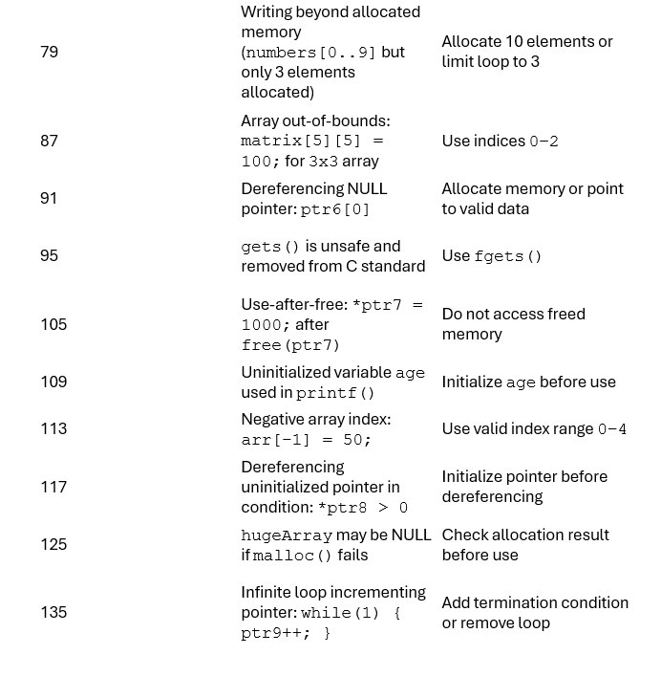
problem no 5

Slide 11
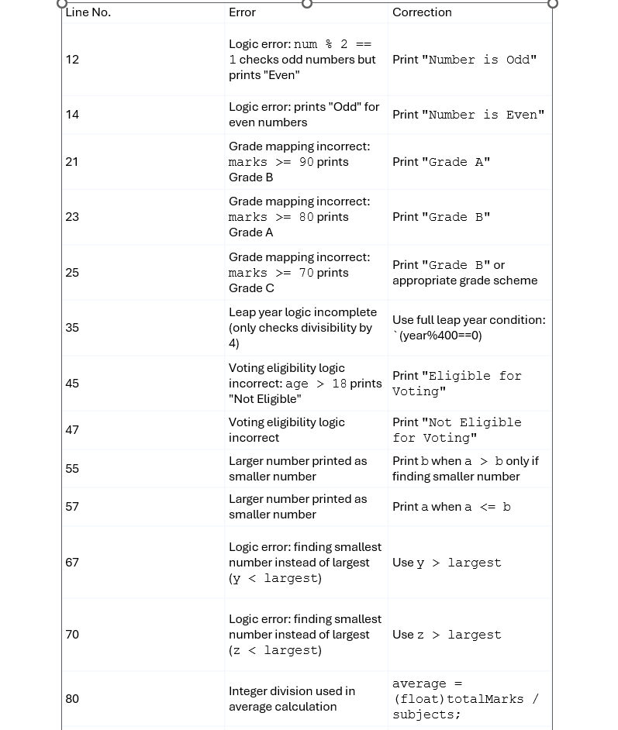
problem no6

Slide 12
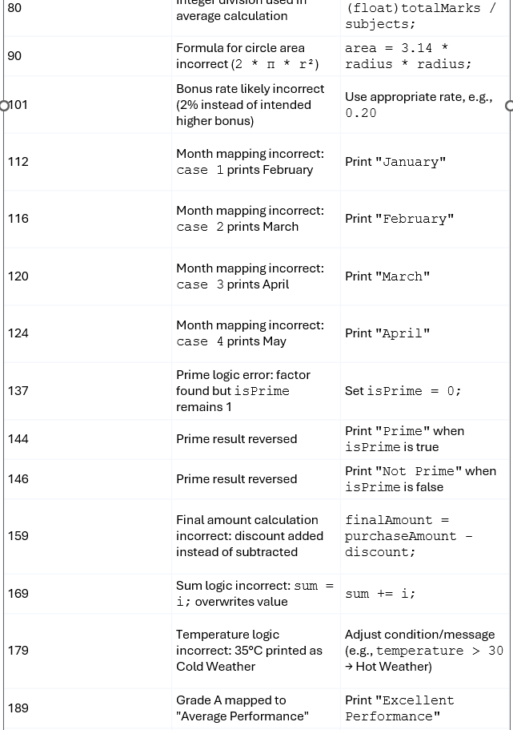
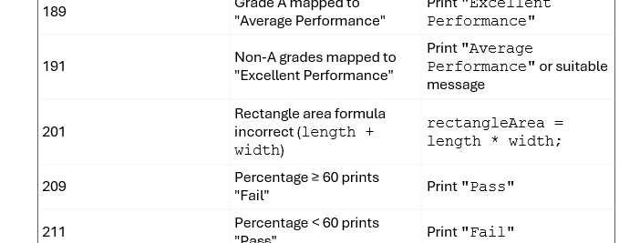
problem no6

Slide 13
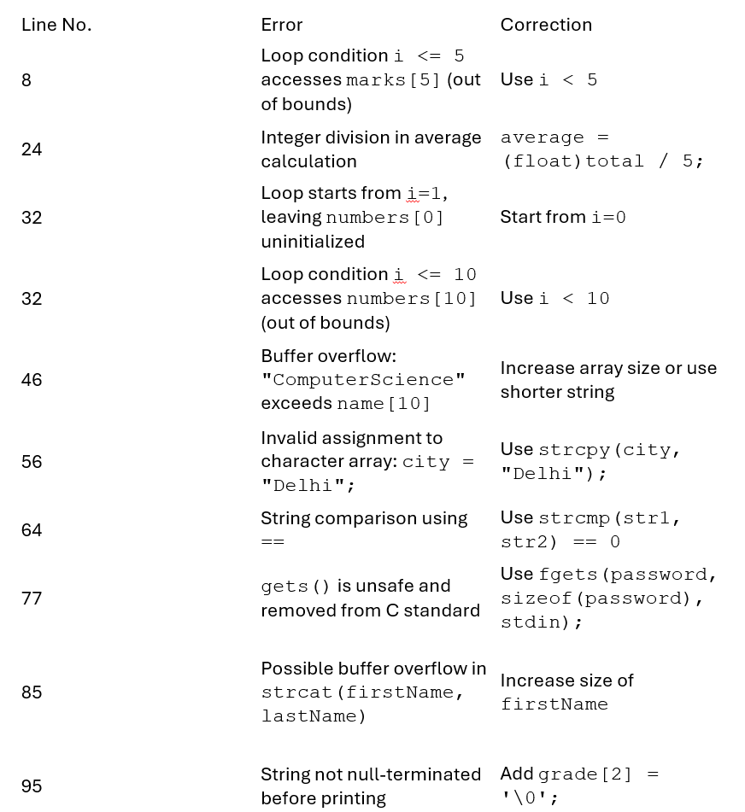
problem no 7

Slide 14
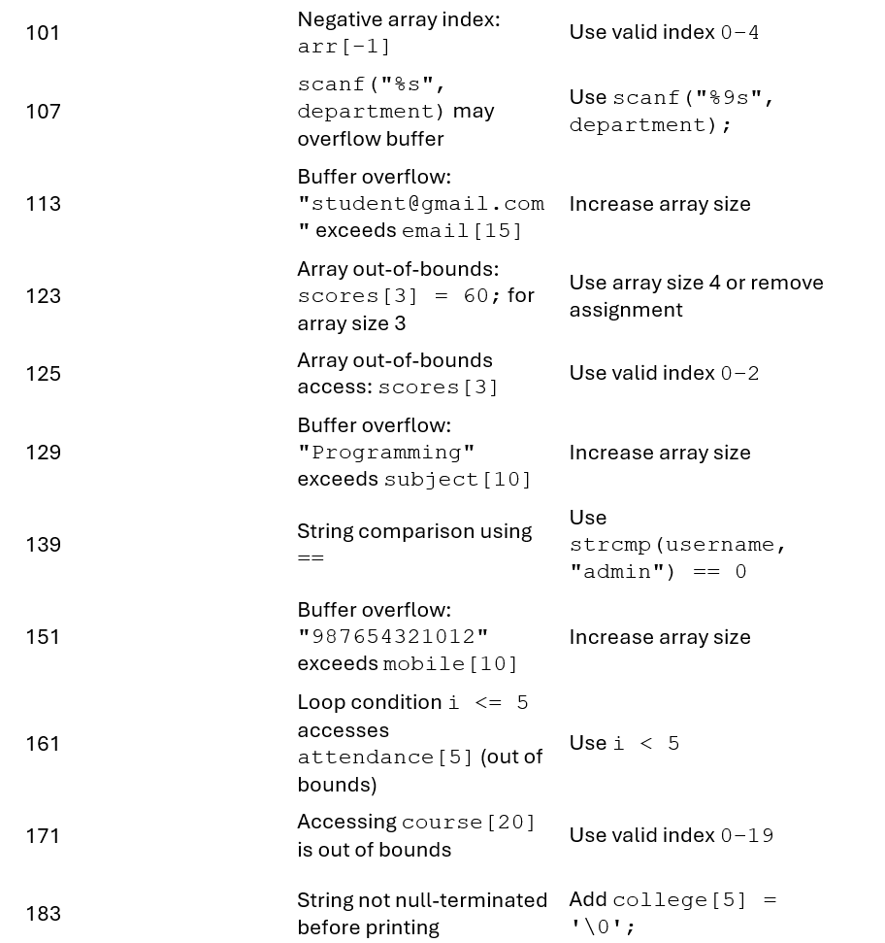
problem no 7

Slide 15
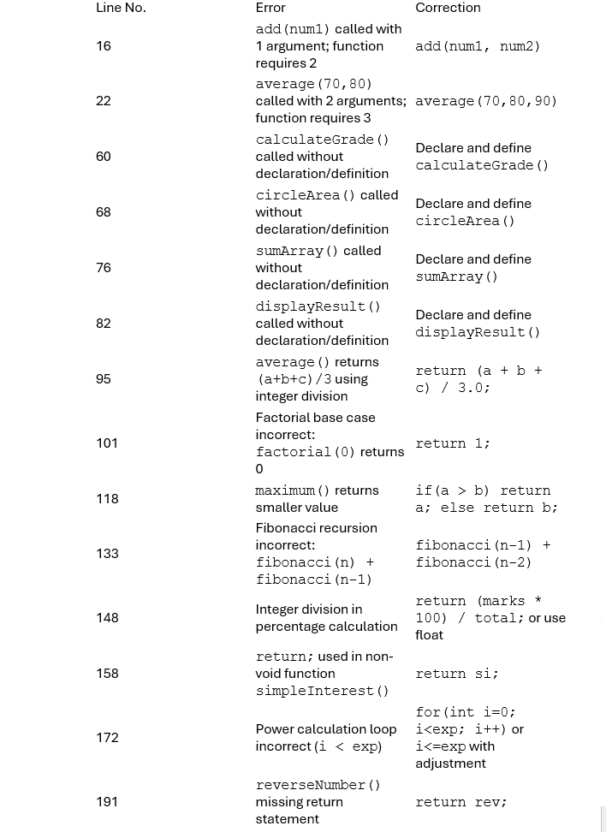
problem no 8

Slide 16
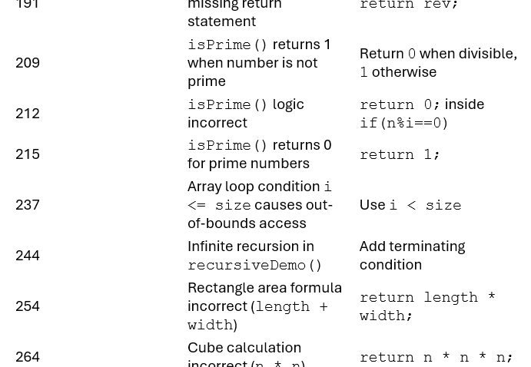
problem no 8

Slide 17
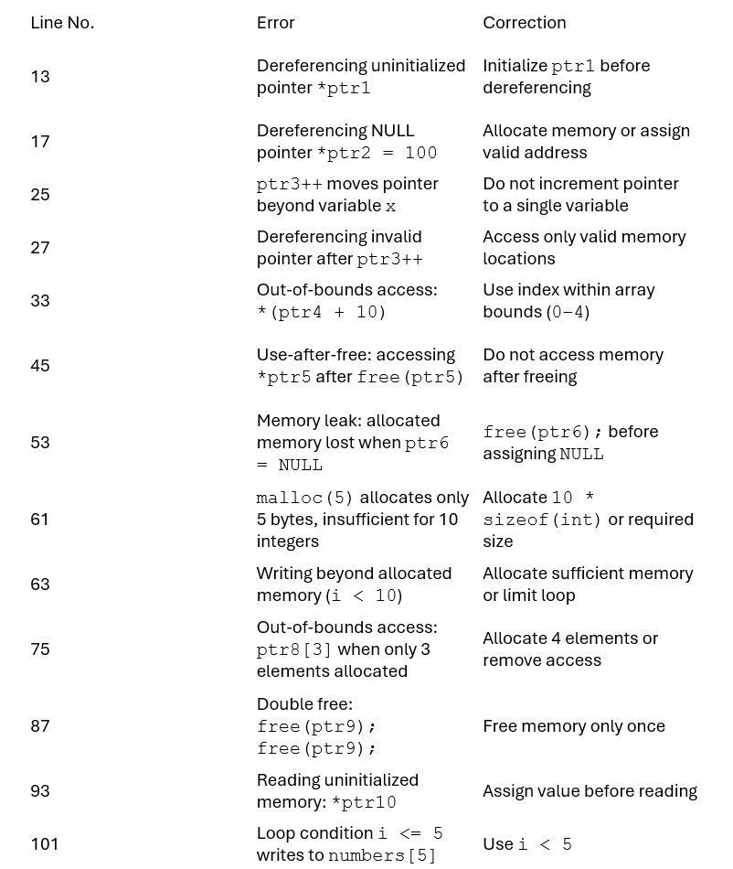
problem no 9

Slide 18
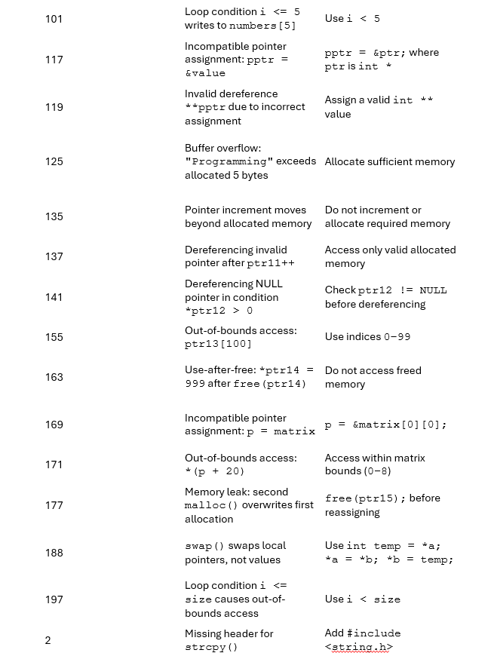
problem no 9

Slide 19
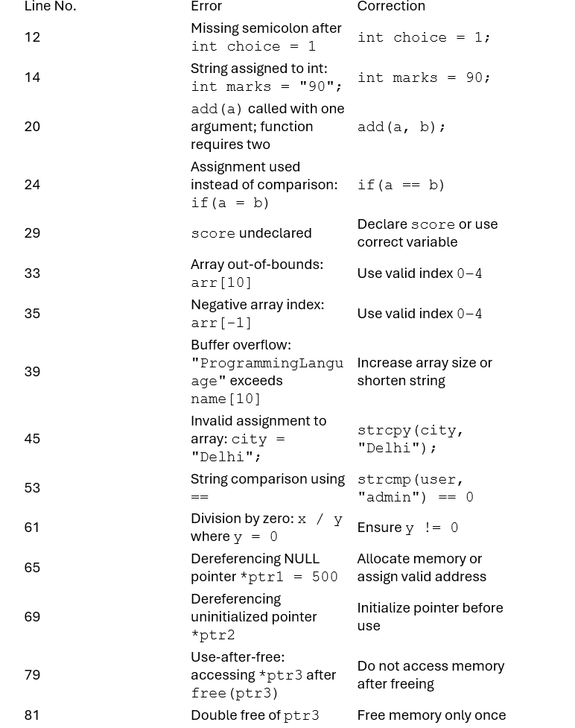
problem no 10

Slide 20
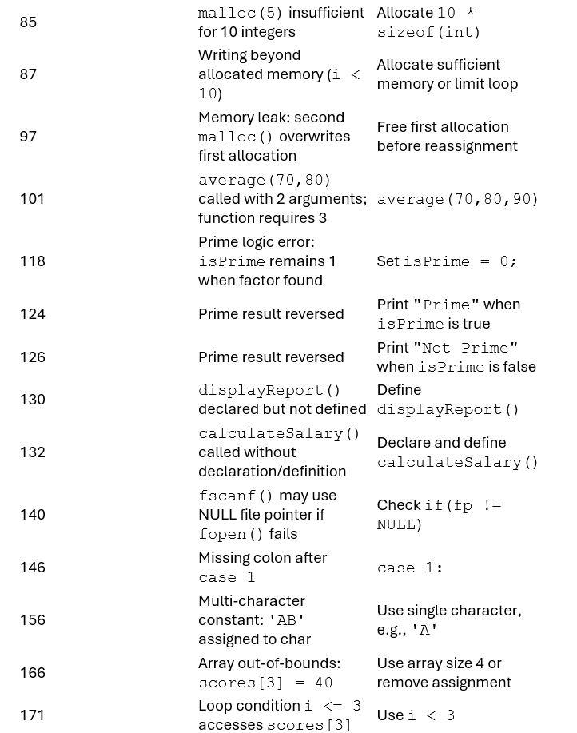
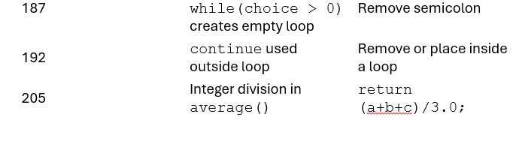
problem no 10

